Slide 1

FUNDTASTIC : MAKE FUNDRAISING FUN AND EASY.
DOWNLOAD NOW !
Project Associates: (Batch-13)
VANGA NAVYA 218X1A05I6
BONIGALA YOGESWARARAO 218X1A05D9
VEPURI SMILY 218X1A05G7
YARRAM SAGAR 218X1A05H3
UNDER THE GUIDENCE OF:
MR. CH. SAMSONU

Slide 2
CONTENTS
Abstract
Introduction
Literature Survey
Existing System
Proposed System
Hardware & Software Requirements
System Requirements Specification
Architecture
Modules
Output Screens
Conclusion
References

Slide 3
ABSTRACT
A fundraiser application is a web-based platform designed to streamline the process of organizing and participating in fundraising activities. These apps provide users with the tools to create and customize fundraising campaigns, engage with donors and supporters, securely process donations, organize fundraising events, and access valuable data and analytics for campaign performance.
Users can also explore nonprofit and cause profiles, access resources for successful fundraising, and leverage social sharing to expand their reach. With a strong emphasis on privacy and security, these applications ensure the safety of users personal and financial information.

Slide 4
INTRODUCTION
This project aims to develop a Fundraising and Investment Platform utilizing the MERN stack (MongoDB, Express.js, React.js, and Node.js). The platform connects individuals seeking to raise funds for their projects with potential investors. It provides a user-friendly interface for both fundraisers and investors, facilitating efficient communication and transaction management.
User Features
User Fundraiser
Registration and Login
Raise Fund Request
View Raised Requests
Profile Management
Logout

Slide 5
PROJECT IDEA
The project includes the following data models:
User Model: Captures user details, authentication, roles (fundraiser or investor), and associated campaigns and investments.
Campaign Model: Represents fundraising campaigns with attributes like title, description, goal amount, current amount raised, status, and bank details.
Investment Model: Tracks investments made by users, including the amount, associated campaign, and status.
Activity Model: Records user activities within the platform, enabling tracking of actions performed by users.

Slide 6
MOTIVATION OF THE PROJECT
The primary motivation behind developing the Fundraising and Investment Platform stems from the increasing need for efficient and transparent financial collaboration in today's dynamic economy. With the rise of startups and social initiatives, there is a growing demand for accessible funding sources.
Key Motivations Include:
Empowering Entrepreneurs: Many innovative ideas fail to secure funding due to a lack of visibility or effective communication channels with investors.
Simplifying Investment Processes: For investors, navigating the landscape of funding opportunities can be daunting.

Slide 7
PROBLEM STATEMENT
In today's fast-paced economic landscape, many aspiring entrepreneurs and project leaders struggle to secure funding for their innovative ideas.
Key Issues Include:
Limited Visibility for Fundraisers: Many individuals and small businesses have innovative projects but lack the means to effectively showcase their ideas to a wider audience of potential investors.
Complex and Time-Consuming Investment Processes: Investors face challenges in discovering suitable investment opportunities that align with their interests.
Lack of Transparency and Trust: Many funding platforms do not provide adequate information on how funds are utilized.

Slide 8
GOALS
The primary goal of the Fundraising and Investment Platform is to create an innovative and user-friendly online environment that bridges the gap between entrepreneurs seeking funding and investors looking for viable investment opportunities.
Develop a User-Centric Platform : Create an intuitive interface for both fundraisers and investors to ensure a seamless user experience.
Facilitate Efficient Fundraising : Enable users to easily register, create, and manage fundraising campaigns with essential details such as project descriptions, goals, and progress updates.

Slide 9
LITERATURE SURVEY
The literature on crowdfunding platforms blockchain technology, reveals significant insights into the advantages and challenges of such systems.
Decentralization and Security: Blockchain technology, particularly Ethereum, conditions are met [1][5].
User Engagement and Accessibility: Platforms developed using the MERN stack campaigns [2][3].
Development Insights: The development of crowdfunding platforms requires operation[4].
1.researchgate.net - Secure and Transparent Crowdfunding using Blockchain
2.github.com - Balaji-Ganesh/CrowdHelp-Blockchain-based-crowdfunding-platform
3.researchgate.net - Developing a Social Platform using MERN Stack
4.vlinkinfo.com - Crowdfunding Platform Development Guide: How to Build ...
5.ijsrem.com - Literature Review of Crowdfunding Blockchain

Slide 10
EXISTING SYSTEM
The current landscape of fundraising and investment platforms is characterized by a variety of solutions, each with its own strengths and weaknesses.
Disadvantages :
1.High Fees and Commissions
2.Lack of Transparency
3.Lack of Transparency
4.Complex User Experience
5.Limited Support for Niche Projects

Slide 11
PROPOSED SYSTEM
The Fundraising and Investment Platform aims to create a simple, secure, and transparent way for fundraisers and investors to connect. It will address the problems in existing systems and offer better features for both parties. Below is an outline of the key parts of the system.
1. System Overview
2. User Interface (UI) and User Experience (UX)
3. Scalability and Future Enhancements

Slide 12
HARDWARE REQUIREMENTS
Operating system : Windows 7 or 7+
Ram : 8 GB
Hard disc or SSD : More than 500 GB
Processor : Intel 3rd generation or high with 8 GB Ram
Software’s : Java 8 or high version, Eclipse.

Slide 13
SOFTWARE REQUIREMENTS
Scripts : JavaScript.
Front End : React js ,Html,Css
Technology : Node Js
Database Connectivity : JDBC
Database : MongoDbs

Slide 14
SYSTEM REQUIREMENTS SPECIFICATION
Functional Requirements
The functional requirements define the specific operations, behaviours, and features that the Fundraising and donation Platform must perform. These requirements are grouped by user roles: Fundraisers (Users) and donors.
Non Functional Requirements
Non-functional requirements describe the quality attributes, performance metrics, and operational aspects of the Fundraising and Investment Platform. These ensure that the platform is secure, scalable, and user-friendly, while also providing a good user experience.

Slide 15
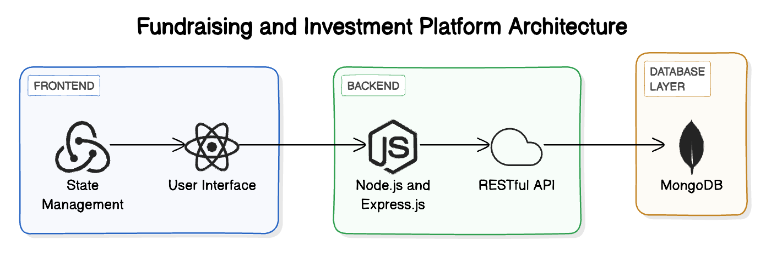
ARCHITECTURE

Slide 16
MODULES
1. ADMIN
Admin Dashboard : Visual displays of total funds raised, number of active campaigns, new users, and recent donations.
Campaign Management : List of all campaigns with essential details (title, goal, amount raised, status).
Donation Management : Monitor all donations made, including donor information and associated campaigns.
Security and Compliance : Keep logs of admin actions for accountability and transparency.

Slide 17
2. USER
Registration:
User Sign-up: When a user signs up, they send their name, email, and password to the backend via a POST request.
Password Hashing: The backend uses a library like bcrypt to hash the password before saving it in the database for security purposes.
Login:
User Login: When a user logs in, they provide their email and password.
Password Verification: The backend checks if the user exists and compares the provided
password with the hashed password stored in the database using bcrypt.compare().

Slide 18
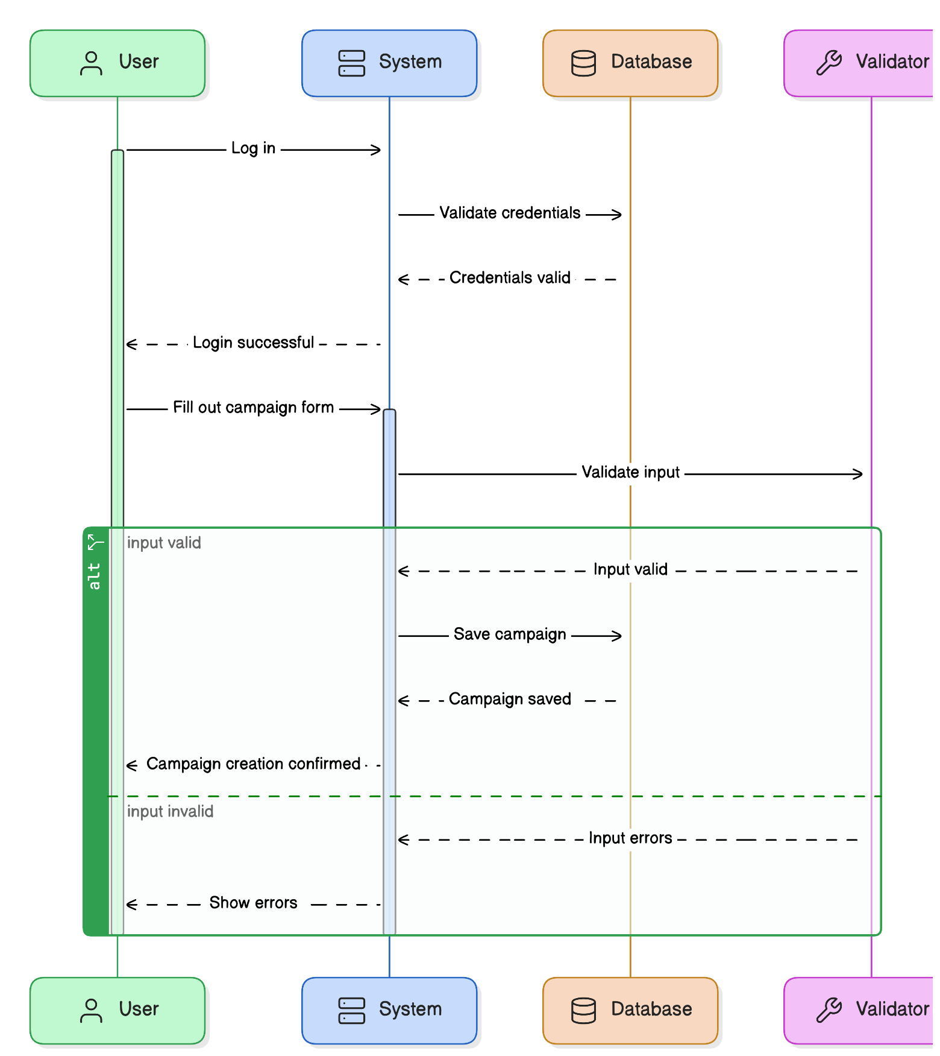
UML DIAGRAM

Slide 19
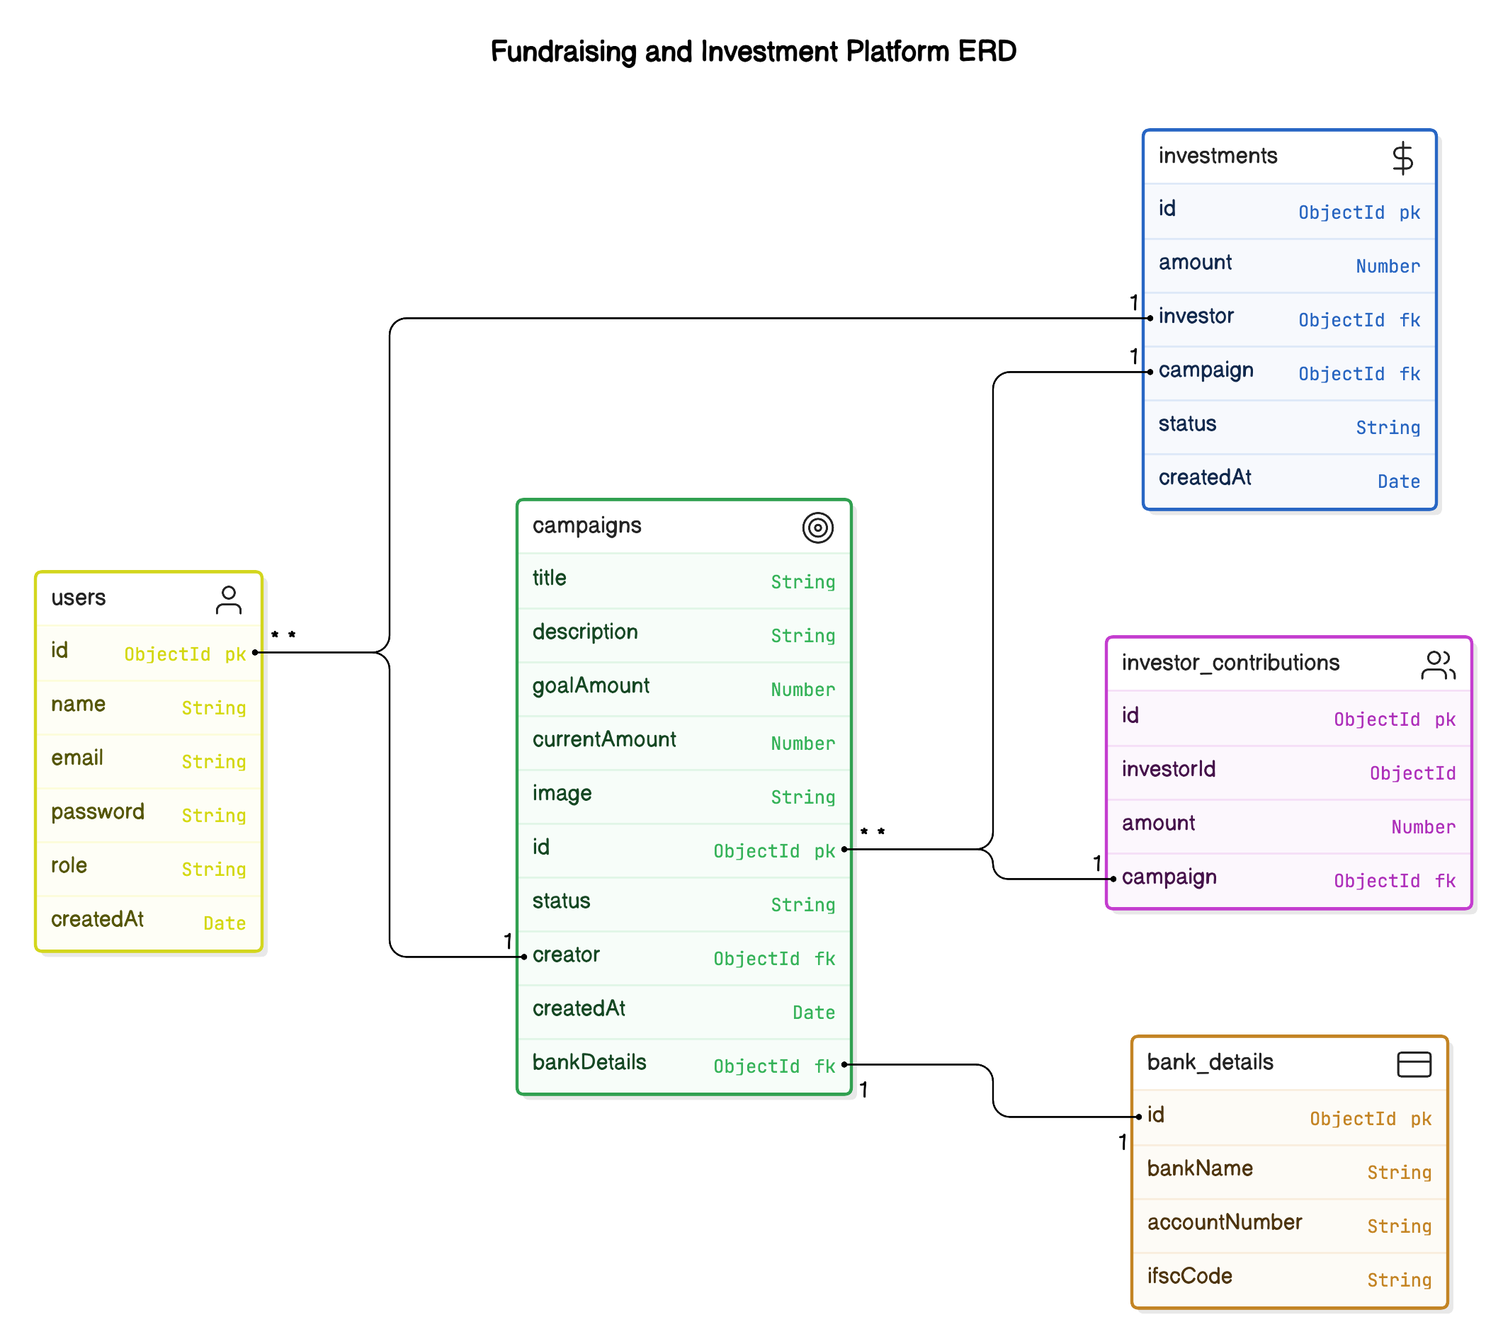
CLASS DIAGRAM

Slide 20
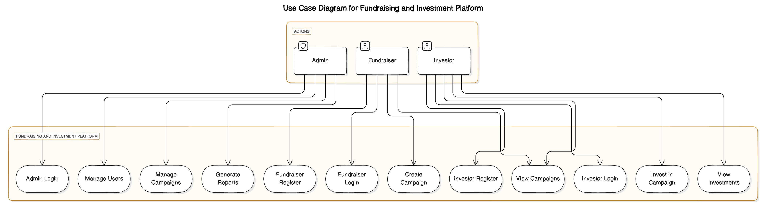
USE CASE DIAGRAM

Slide 21
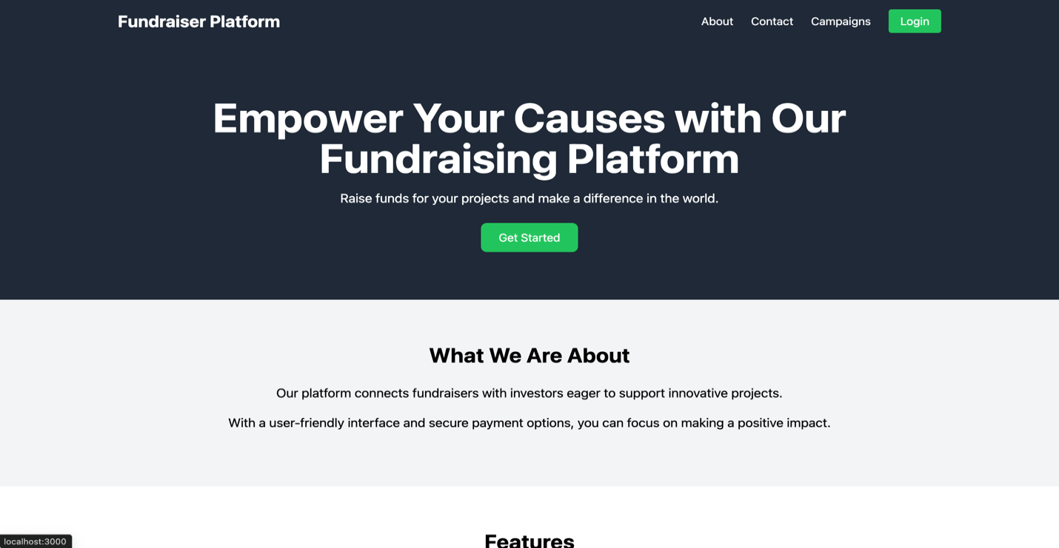
OUTPUT SCREENS
Home Page

Slide 22
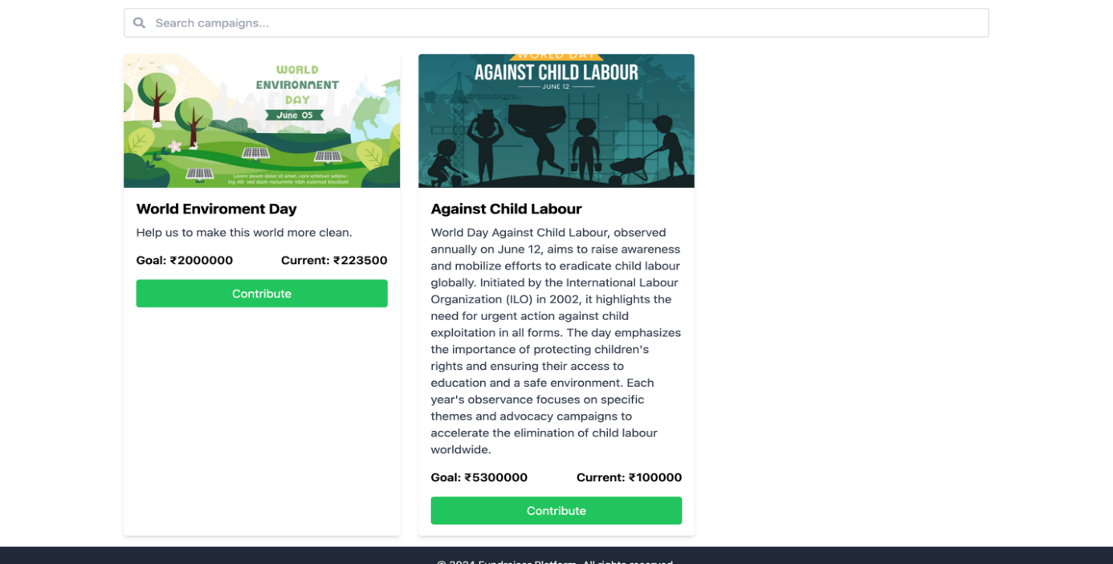
Campaigns Page

Slide 23
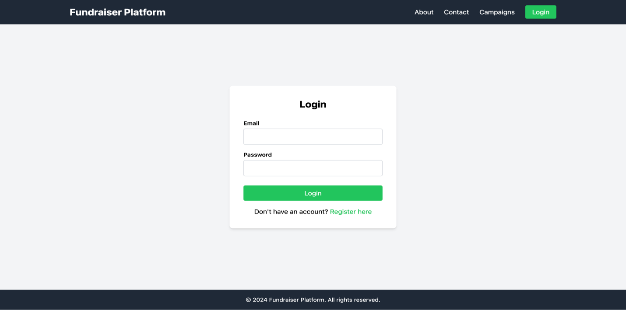
Login page

Slide 24
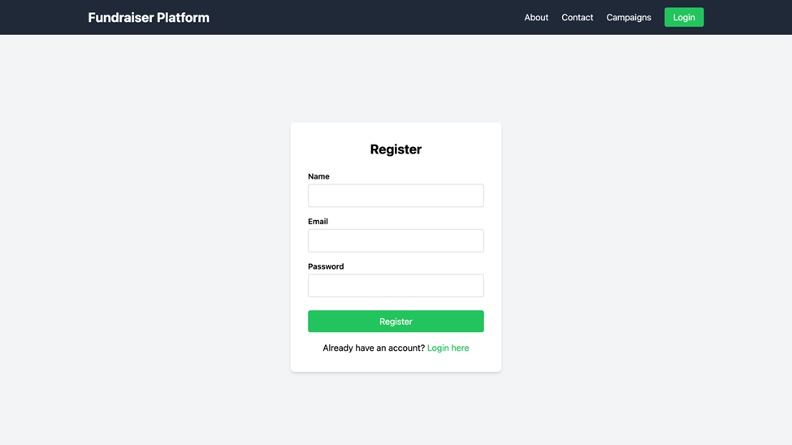
Register Page

Slide 25
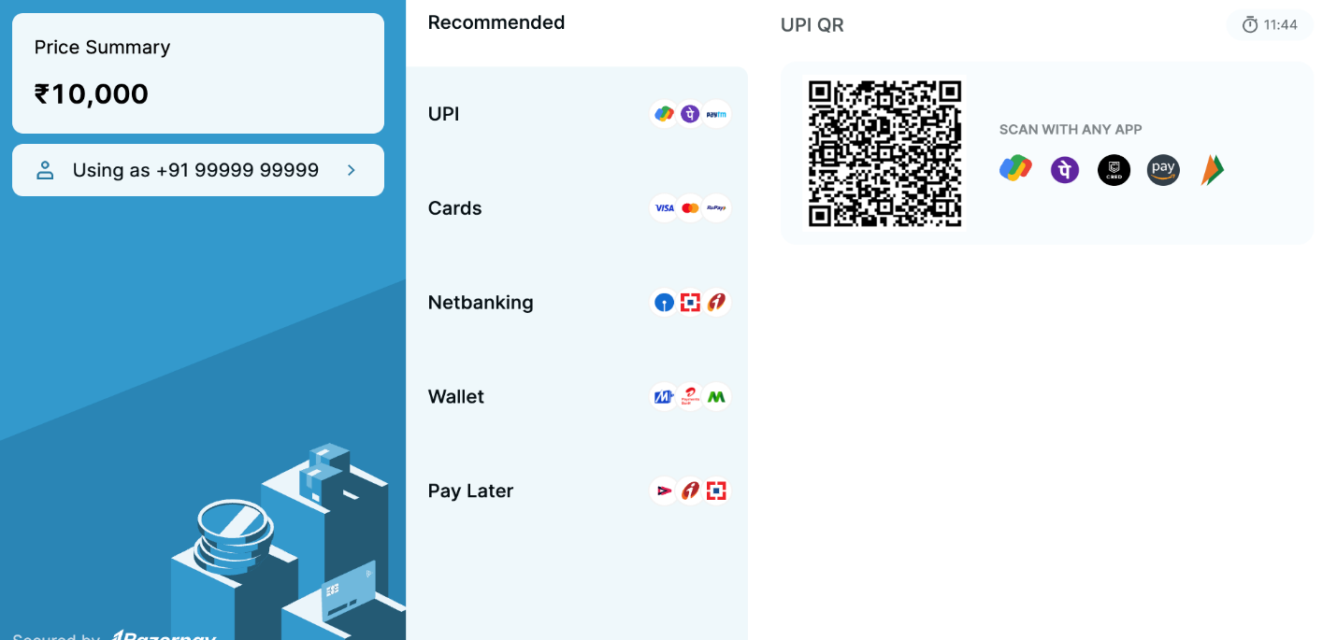
Razor pay

Slide 26
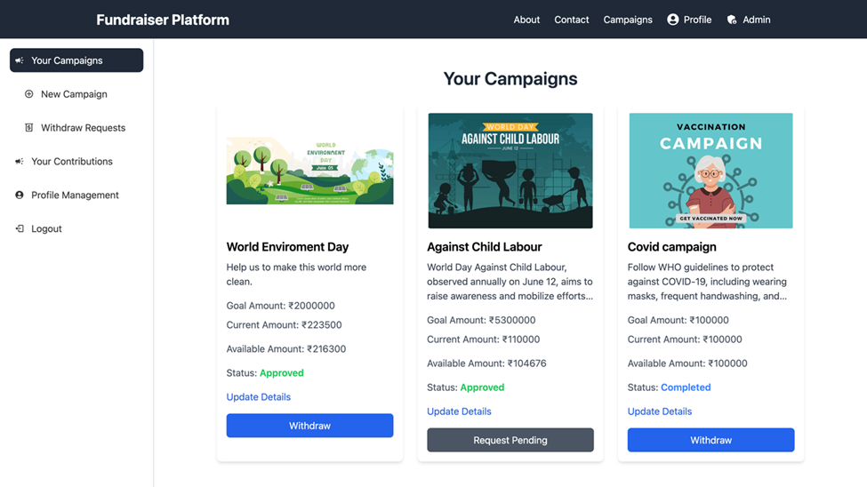
Your Campaigns Page

Slide 27
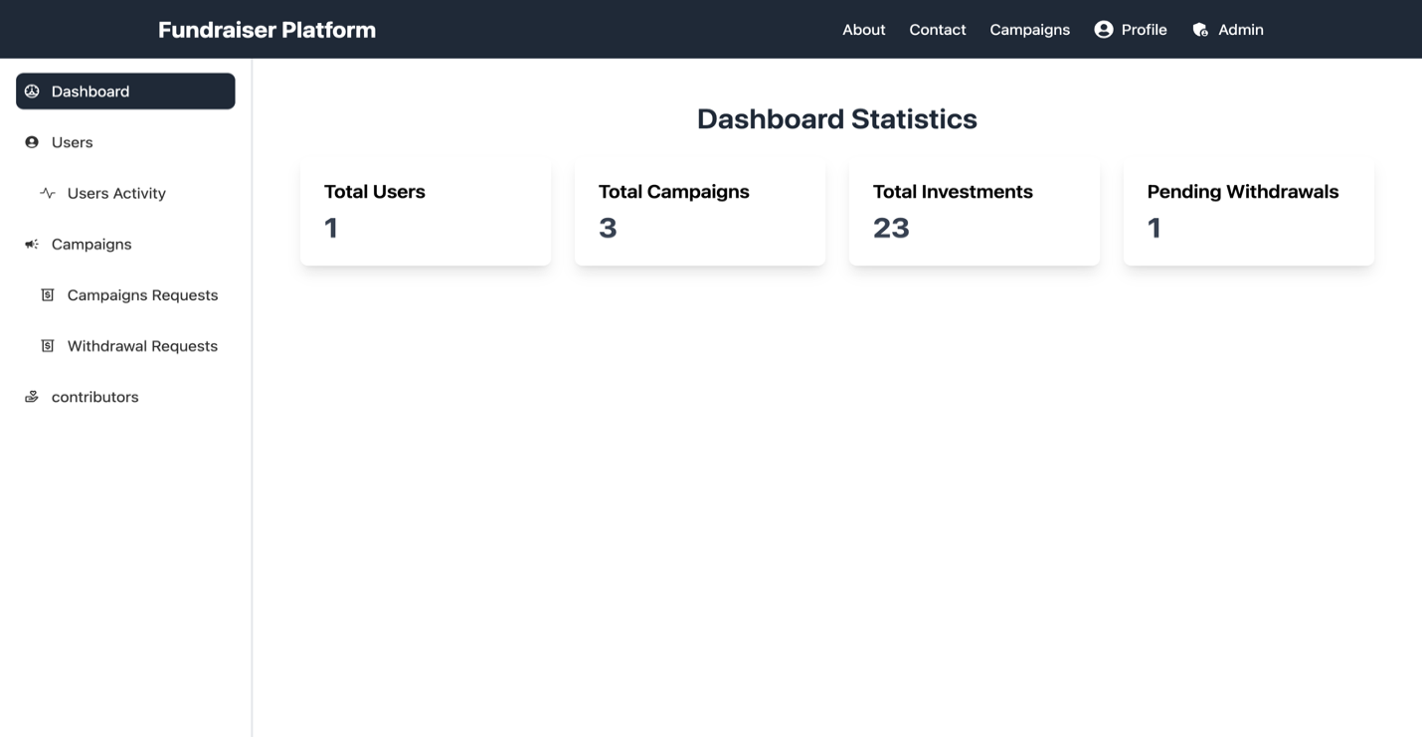
Admin Panel

Slide 28
CONCLUSION
In conclusion, our fundraising campaign has not only highlighted the importance of our mission but has also fostered a sense of community and shared purpose among our supporters. The funds raised will directly impact our programs, allowing us to expand our reach and enhance the services we provide to those in need. Thank you for believing in our mission and for your unwavering support. Together, we are not just making a difference; we are building a legacy of hope and resilience that will resonate for years to come. Your involvement is crucial, and we look forward to continuing this journey with you as we strive to create a brighter future for those we serve.

Slide 29
REFERENCES
1. Statistical Data:
Utilizing statistics can highlight the need for support. For example, referencing studies or reports from reputable organizations can illustrate the scope of a problem, such as poverty rates or health disparities.
Example: “According to the World Health Organization, over 1 billion people lack access to clean water, underscoring the urgent need for our clean water initiatives.”
2. Success Stories:
Sharing case studies or testimonials from individuals who have benefited from your programs can be compelling. These stories personalize your mission and show tangible results.
Example: “Meet Sarah, a participant in our job training program, who secured a full-time job within three months of completing the course.”
3. Research Findings:
Citing peer-reviewed research can bolster your organization’s credibility, especially if it supports the effectiveness of your programs.
Example: “A study published in the Journal of Public Health found that our approach to community health outreach reduced emergency room visits by 30%.”

Slide 30


